Slide 1


Serverless Holiday Hackathon 2023

Slide 2
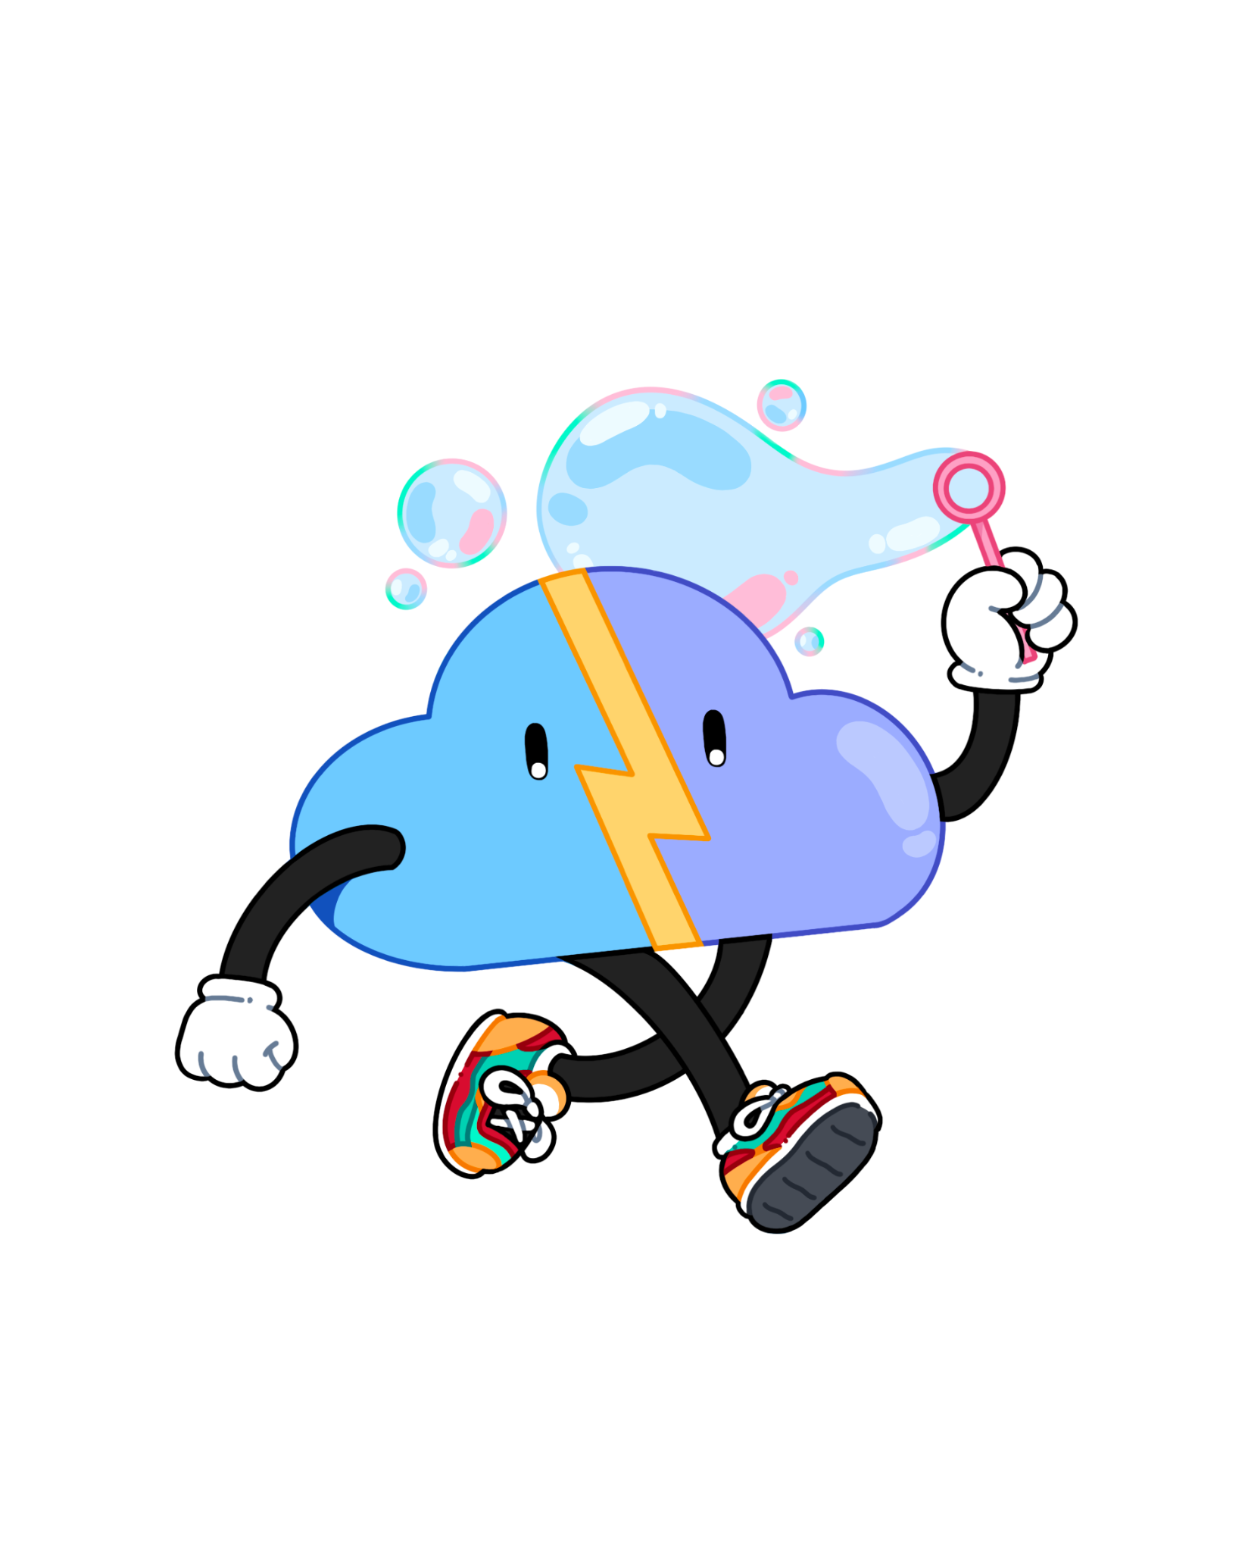


Our plans for today
About Serverless Guru
Langchain Deep Dive
Choosing your Serverless API
Q & A

Slide 3
About Serverless Guru
Your Guide to Serverless Adopt. Migrate. Build.

Slide 4
Our Company
We love to take on challenges, face the unknown, and be on the forefront of serverless innovation.
Helping companies and people realize their full potential gives us energy.
Speak to a Guru today!

Slide 5
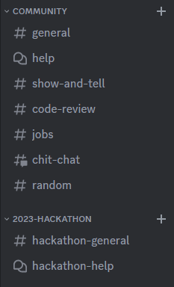
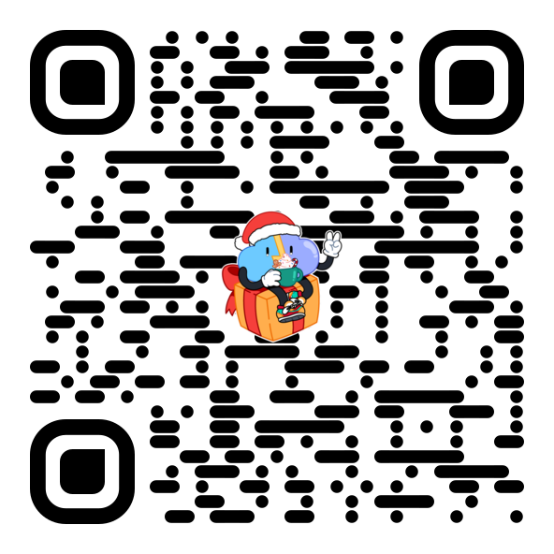
Join our discord Server!

Slide 6
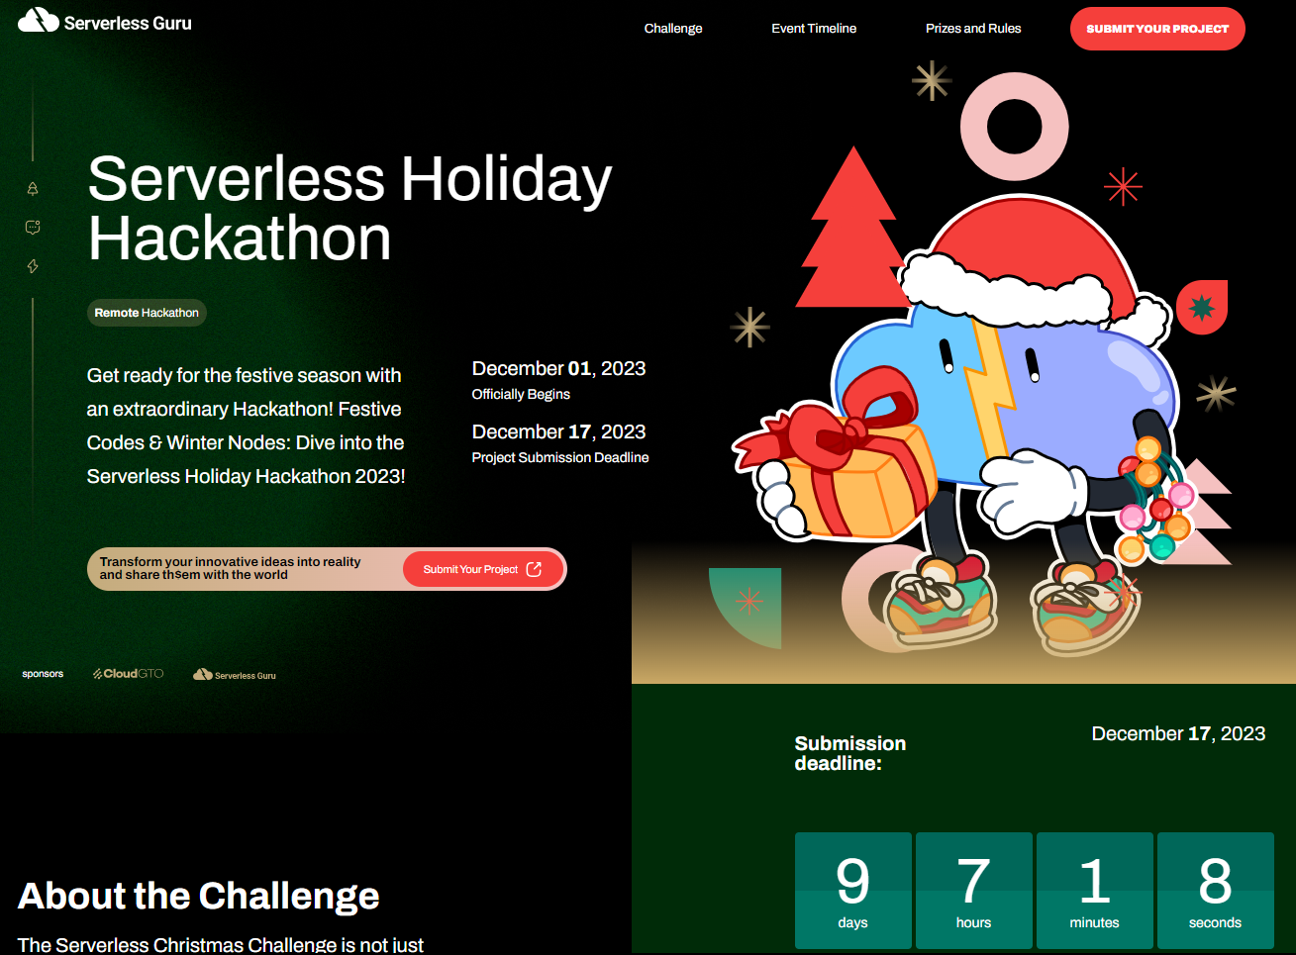
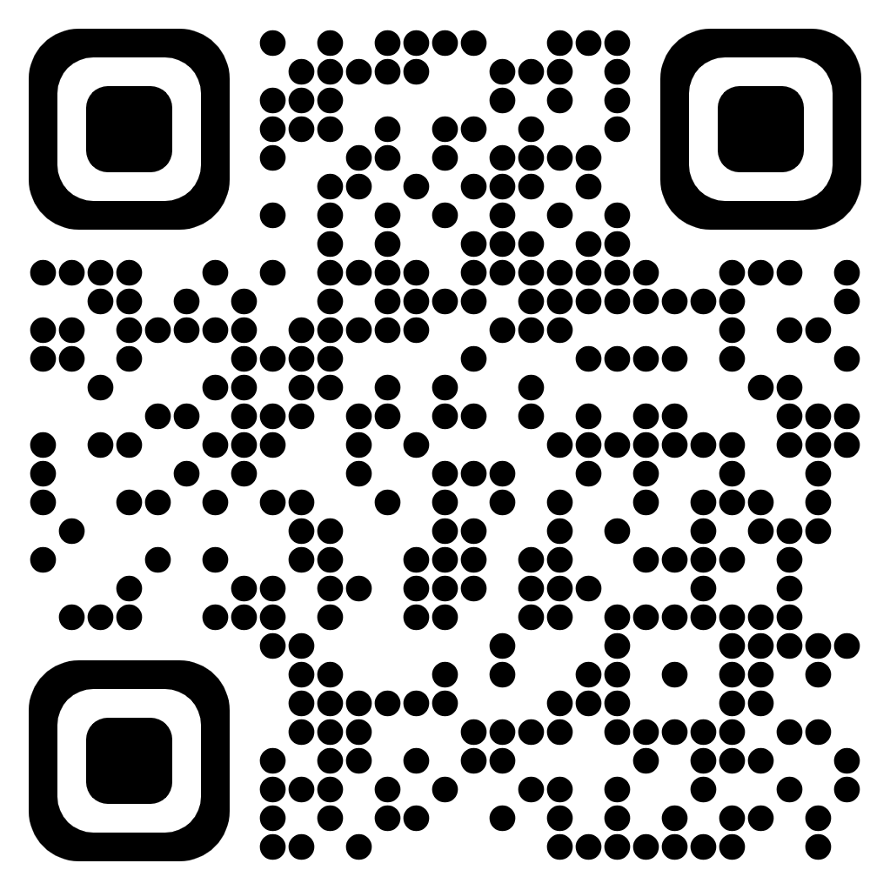
Submissions Form

Slide 7
Langchain Deep Dive
Everything you need to know about Langchain Conversation Chains and production monitoring with langsmith

Slide 8
Choosing your Serverless API
Options, Challenges and Recommendations

Slide 9
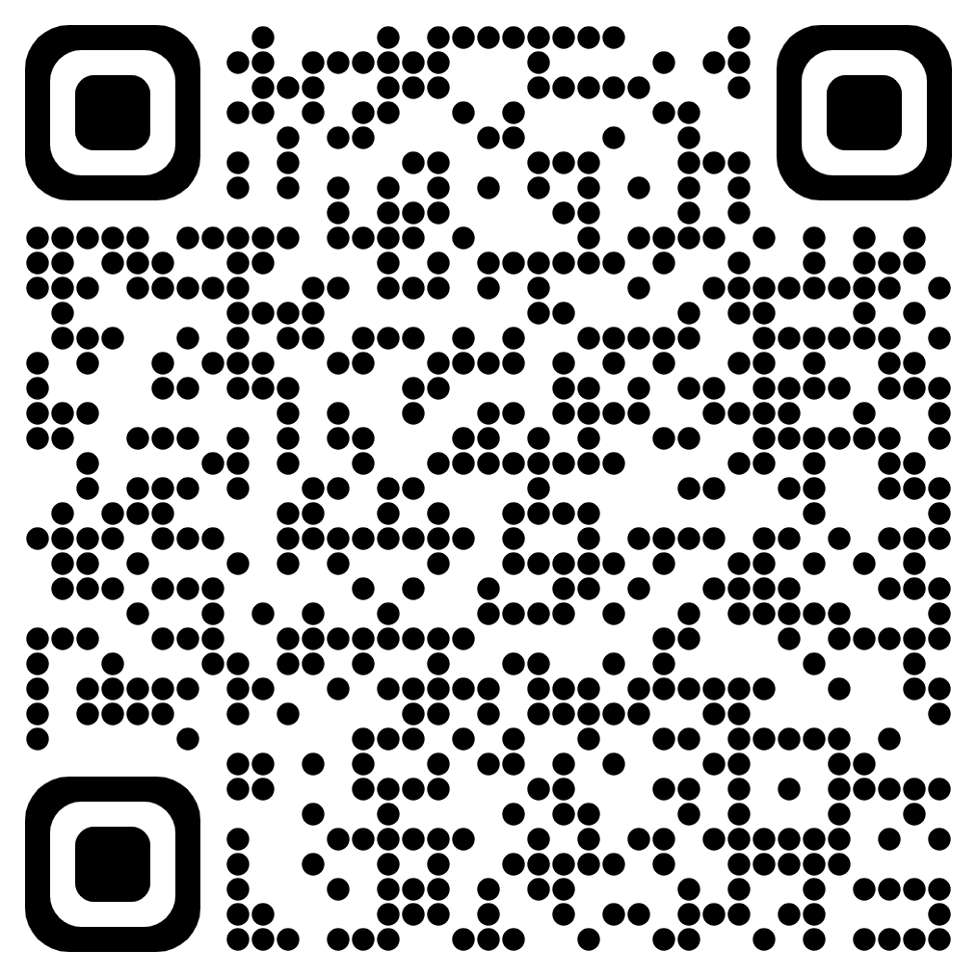
REST API
What is a Rest API?
A REST API in API Gateway is a collection of resources and methods that are integrated with backend HTTP endpoints. API Gateway REST APIs use a request/response model where a client sends a request to a service and the service responds back synchronously.

Slide 10
REST API
Limitations
Payload Size of max 10MB.
Maximum integration timeout 30 seconds.
Timeout for Lambda authorizer response 10 seconds.

Slide 11
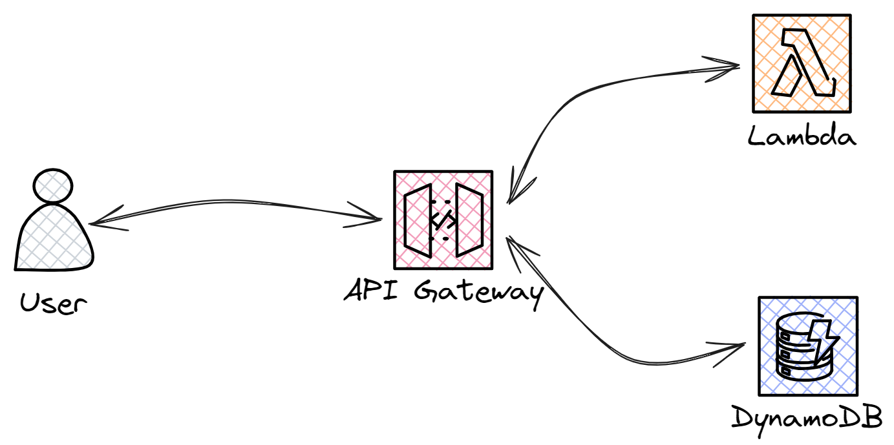
REST API
Basic Architecture

Slide 12
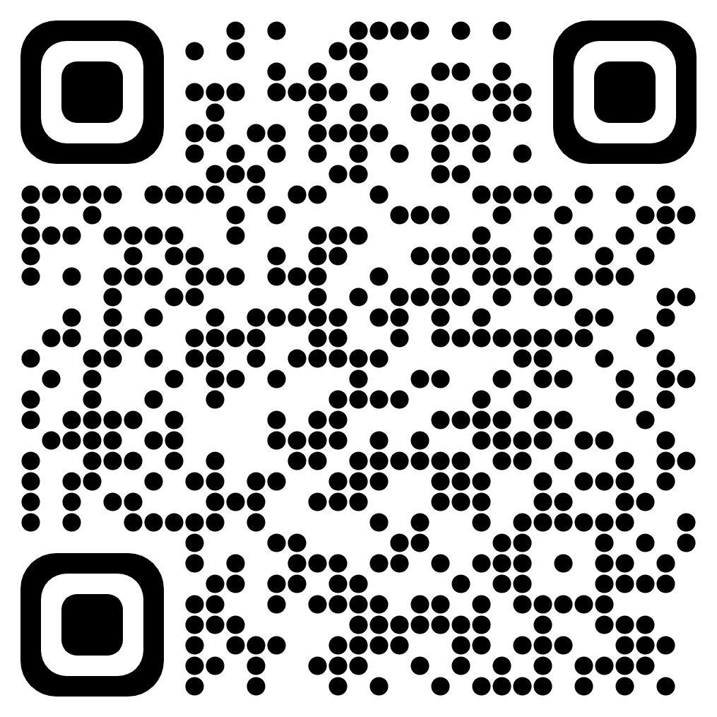
Websocket API
What are WebSockets?
WebSockets represent a communication protocol that facilitates real-time, bidirectional data exchange between clients and servers over a single, long-lived connection.

Slide 13
Websocket API
Limitations
Integration timeout of 30 seconds.
Connection duration for WebSocket API 2 hours.
Idle Connection Timeout 10 minutes.
Message payload size 128 KB.

Slide 14
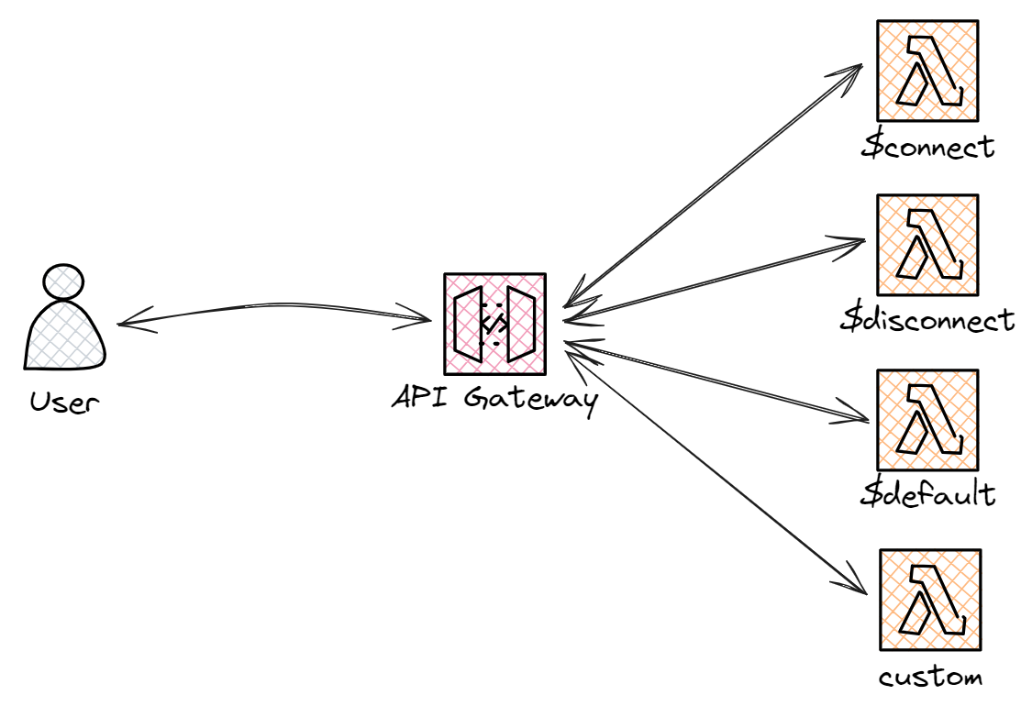
Websocket API
Basic Architecture

Slide 15
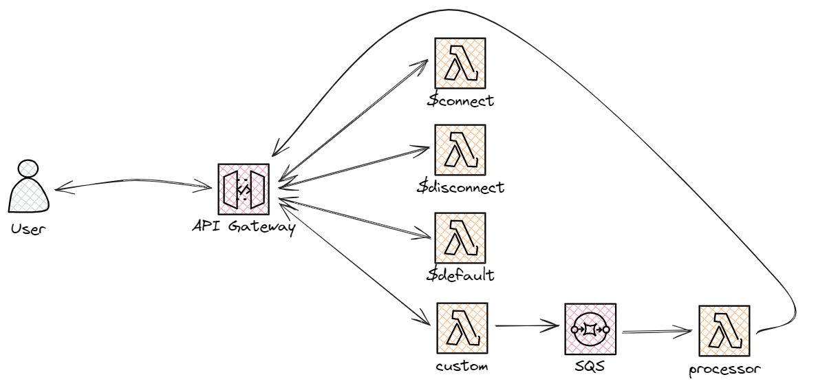
Websocket API
Basic Architecture

Slide 16
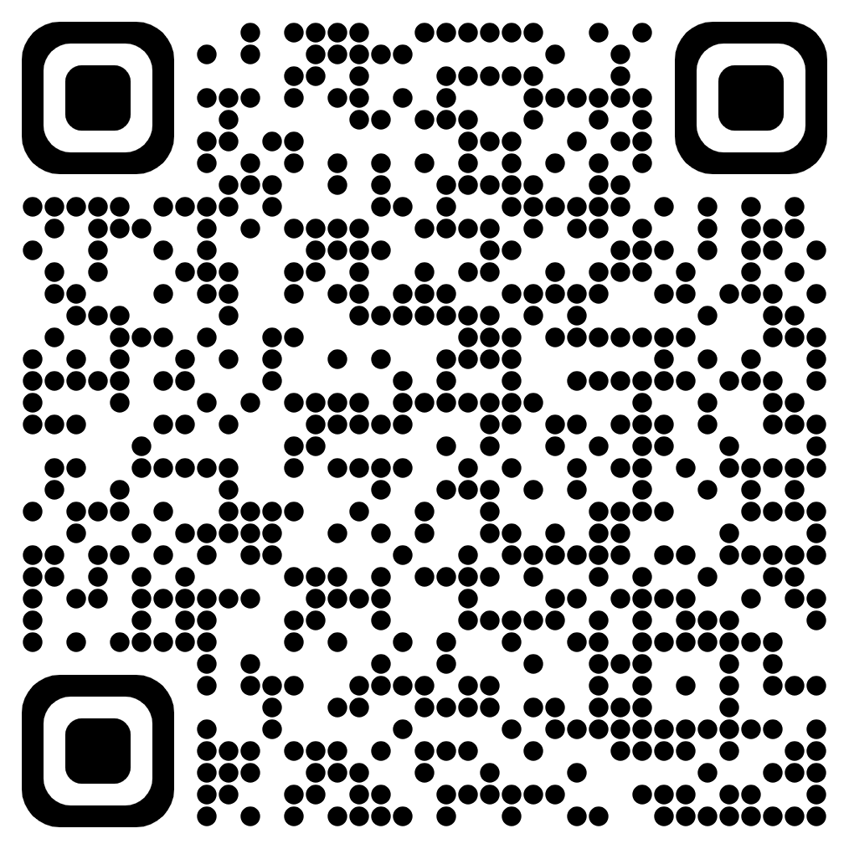
AppSync Subscriptions
What are Appsync Subscriptions?
When clients invoke the GraphQL subscription operations, a secure WebSocket connection is automatically established and maintained by AWS AppSync. Applications can then distribute data in real-time from a data source to subscribers.

Slide 17
AppSync Subscriptions
Limitations
Subscriptions are only triggered when the associated mutation is executed.
Maximum size of a message that can be received through subscriptions is 240 kilobytes.
AWS AppSync limits the execution time for mutations, queries, and subscriptions to 30 seconds.

Slide 18
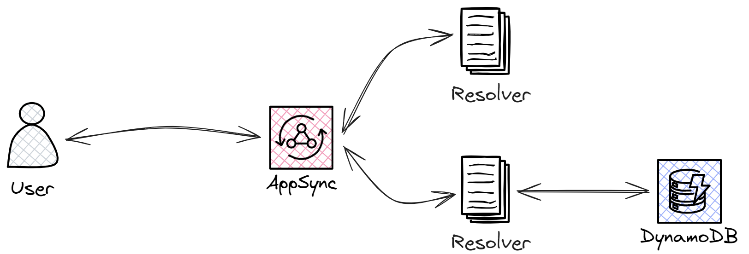
AppSync Subscriptions
Basic Architecture

Slide 19
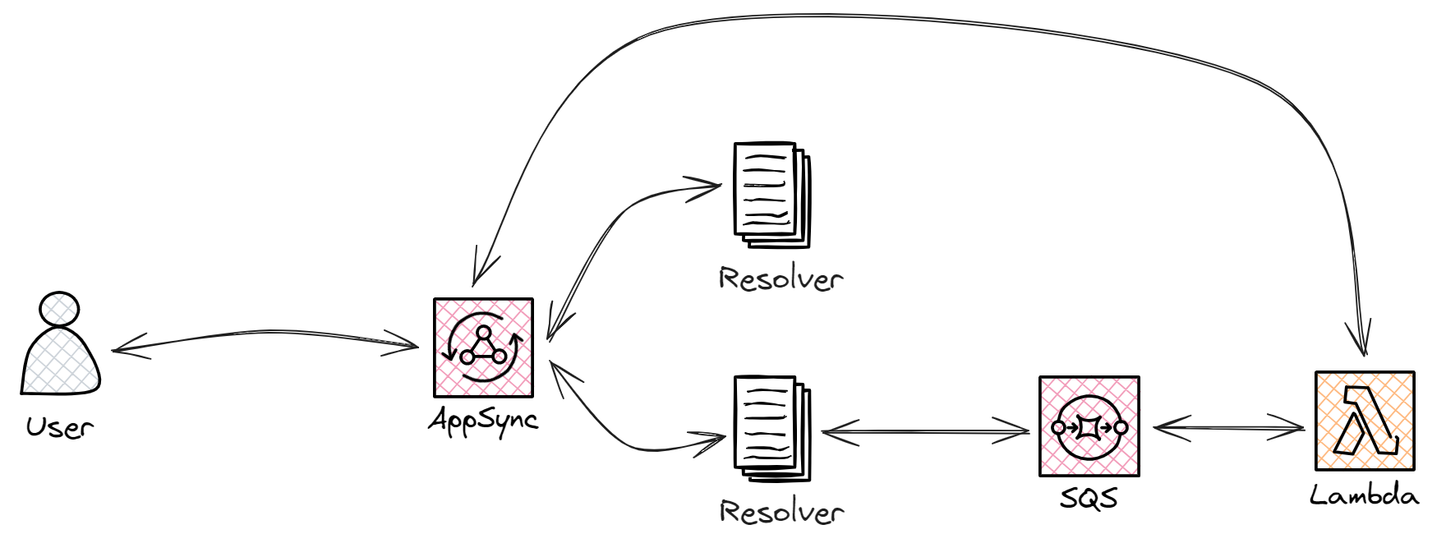
AppSync Subscriptions
Basic Architecture

Slide 20
Questions & Answers
We are here to help!
Raise any questions or concerns you might have

Slide 21
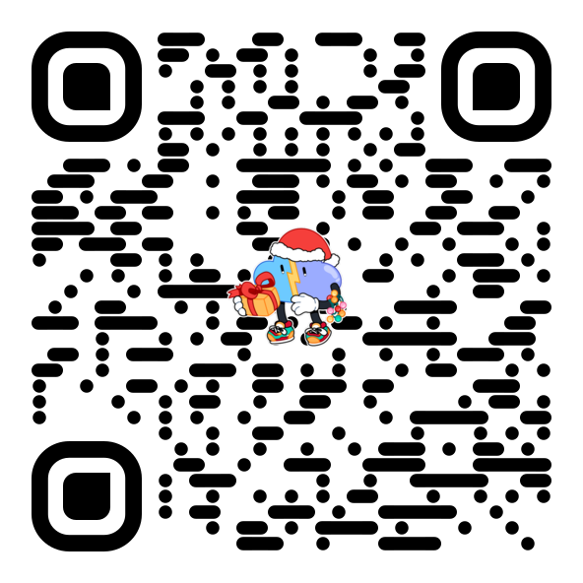
Thank you!
Join our discord Server!
Sign up for the challenge!

